Slide 1
Pre-Announcements
Your friend from this class is here to tell you about an event.
Sutardja senter for Entrepreneurship is holding a hackathon called Cal Innovates.
April 14th/15th [?]. Open to anybody, CS, econ, business, premed, etc.
Recruiters from all sorts of companies will be there.
Prizes will be there, not just electronics gadgets, but also ability to pitch to Skydeck which is a venture capital firm in house at Berkeley.
Register by this Thursday for raffle eligibility.
Innovateatcal.com

Slide 2
Announcements
Proj3: It’s out. If you haven’t started yet, you are behind.

Slide 3
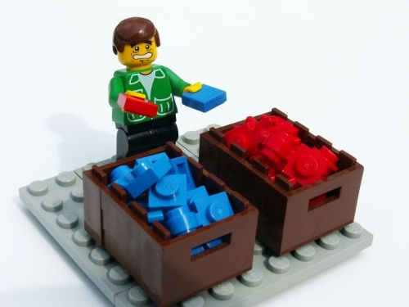
CS61B
Lecture 32: Sorting I
The Sorting Problem
Selection Sort, Heapsort
Mergesort
Insertion Sort
Shell’s Sort (Extra)

Slide 4
Sorting - Definitions
A sort is a permutation (re-arrangement) of a sequence of elements that brings them into order according to some total order. A total order ≼ is:
Total: x ≼ y or y ≼ x for all x, y
Reflexive: x ≼ x
Antisymmetric: x ≼ y and y ≼ x iff x = y (x and y are equivalent).
Transitive: x ≼ y and y ≼ z implies x ≼ z.
In Java, total order is typically specified by compareTo or compare methods.
May be inconsistent with equals! For example sorting an array of Strings by length has items that are equivalent, but not equal, e.g. “cat” and “dog”.

Slide 5

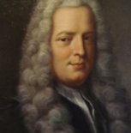
Sorting: An Alternate Viewpoint
An inversion is a pair of elements that are out of order.
0 1 1 2 3 4 8 6 9 5 7
8-6 8-5 8-7 6-5 9-5 9-7
(6 inversions out of 55 max)
Yoda
Gabriel Cramer
Goal of sorting:
Given a sequence of elements with Z inversions.
Perform a sequence of operations that reduces inversions to 0.

Slide 6
Performance Definitions
Characterizations of the runtime efficiency are sometimes called the time complexity of an algorithm. Examples:
DFS has time complexity Θ(V+E).
Characterizations of the “extra” memory usage of an algorithm is sometimes called the space complexity of an algorithm.
DFS has space complexity Θ(V).
Note that the graph takes up space Θ(V+E), but we don’t count this as part of the runtime of DFS, since we’re only accounting for the extra space that DFS uses.

Slide 7
Selection Sort and Heapsort
Notes:
5 min to get here

Slide 8
Selection Sort
We’ve seen this already.
Find smallest item.
Swap this item to the front and ‘fix’ it.
Repeat for unfixed items until all items are fixed.
Demo: https://goo.gl/g14Cit
Sort Properties:
Θ(N²) time if we use an array (or similar data structure).
Seems inefficient: We look through entire remaining array every time to find the minimum.

Slide 9
Naive Heapsort: Leveraging a Max-Oriented Heap
Idea: Instead of rescanning entire array looking for minimum, maintain a heap so that getting the minimum is fast!
For reasons that will become clear soon, we’ll use a max-oriented heap.
Naive heapsorting N items:
Insert all items into a max heap, and discard input array. Create output array.
Repeat N times:
Delete largest item from the max heap.
Put largest item at the end of the unused part of the output array.
Naive Heapsort Demo: https://goo.gl/EZWwSJ
A min heap would work as well, but wouldn’t be able to take advantage of the fancy trick in a few slides.

Slide 10
Naive Heapsort Runtime: http://yellkey.com/suffer
Naive heapsorting N items:
Insert all items into a max heap, and discard input array. Create output array.
Repeat N times:
Delete largest item from the max heap.
Put largest item at the end of the unused part of the output array.
What is the TOTAL runtime of naive heapsort?
Θ(N)
Θ(N log N)
Θ(N²), but faster than selection sort.

Slide 11
Heapsort Runtime Analysis
Use the magic of the heap to sort our data.
Getting items into the heap O(N log N) time.
Selecting largest item: Θ(1) time.
Removing largest item: O(log N) for each removal.
Informally, overall runtime is O(N log N) + Θ(N) + O(N log N) = O(N log N)
Far better that selection sort!
Memory usage is Θ(N) to build the additional copy of all of our data.
Worse than selection sort, but probably no big deal (??).
Can eliminate this extra memory cost with same fancy trickery.
Informally?? [good eye!]

Slide 12
In-place Heapsort
Alternate approach, treat input array as a heap!
Rather than inserting into a new array of length N + 1, use a process known as “bottom-up heapification” to convert the array into a heap.
To bottom-up heapify, just sink nodes in reverse level order.
Avoids need for extra copy of all data.
Once heapified, algorithm is almost the same as naive heap sort.
In-place heap sort: Demo
32
15
2
17
19
26
41
17
17
heapification
41
19
32
17
15
26
2
17
17
For this algorithm we don’t leave spot 0 blank.
Notes:
Need more gentle intro with nicer demos. Too big of a jump all at once.

Slide 13
In-place Heapsort Runtime: http://yellkey.com/fail
Use the magic of the heap to sort our data.
Bottom-up Heapification: O(???) time.
Selecting largest item: Θ(1) time.
Removing largest item: O(log N) for each removal.
Give the time complexity of in-place heapsort in big O notation.
O(N)
O(N log N)
O(N²)
Notes:
Need more gentle intro with nicer demos. Too big of a jump all at once.

Slide 14
In-place Heapsort Runtime
Use the magic of the heap to sort our data.
Bottom-up Heapification: O(N log N) time.
Selecting largest item: Θ(1) time.
Removing largest item: O(log N) for each removal.
Give the time complexity of in-place heapsort in big O notation.
O(N log N)
Bottom-up heapification is N sink operations, each taking no more than O(log N) time, so overall runtime for heapification is O(N log N).
Extra for experts, show that bottom-up heapification is Θ(N) in the worst case.
More extra for experts, show heapsort is Θ(N log N) in the worst case.
Notes:
Need more gentle intro with nicer demos. Too big of a jump all at once.

Slide 15
In-place Heapsort: http://yellkey.com/once
What is the memory complexity of Heapsort?
Also called “space complexity”.
Θ(1)
Θ(log N)
Θ(N)
Θ(N log N)
Θ(N²)
Notes:
Need more gentle intro with nicer demos. Too big of a jump all at once.

Slide 16
In-place Heapsort
What is the memory complexity of Heapsort?
Θ(1)
Θ(log N)
Θ(N)
Θ(N log N)
Θ(N²)
The only extra memory we need is a constant number instance variables, e.g. size.
Unimportant caveat: If we employ recursion to implement various heap operations, space complexity is Θ(log N) due to need to track recursive calls. The difference between Θ(log N) and Θ(1) space is effectively nothing.
Notes:
Need more gentle intro with nicer demos. Too big of a jump all at once.

Slide 17
Sorts So Far
 | Best Case Runtime | Worst Case Runtime | Space | Demo | Notes
Selection Sort | Θ(N²) | Θ(N²) | Θ(1) | Link
Heapsort (in place) | Θ(N)* | Θ(N log N) | Θ(1) | Link | Bad cache (61C) performance.
*: An array of all duplicates yields linear runtime for heapsort.

Slide 18
Mergesort

Slide 19
Mergesort
We’ve seen this one before as well.
Mergesort: Demo
Split items into 2 roughly even pieces.
Mergesort each half (steps not shown, this is a recursive algorithm!)
Merge the two sorted halves to form the final result.
Time complexity, analysis from previous lecture: Θ(N log N runtime)
Space complexity with aux array: Costs Θ(N) memory.
Also possible to do in-place merge sort, but algorithm is very complicated, and runtime performance suffers by a significant constant factor.

Slide 20
Sorts So Far
 | Best Case Runtime | Worst Case Runtime | Space | Demo | Notes
Selection Sort | Θ(N²) | Θ(N²) | Θ(1) | Link
Heapsort (in place) | Θ(N)* | Θ(N log N) | Θ(1) | Link | Bad cache (61C) performance.
Mergesort | Θ(N log N) | Θ(N log N) | Θ(N) | Link | Faster than heap sort.
*: An array of all duplicates yields linear runtime for heapsort.

Slide 21
Insertion Sort

Slide 22
Insertion Sort
General strategy:
Starting with an empty output sequence.
Add each item from input, inserting into output at right point.
Naive approach, build entirely new output: Demo (Link)
Input:
32
15
2
17
19
26
41
17
17
Output:

Slide 23
Insertion Sort
General strategy:
Starting with an empty output sequence.
Add each item from input, inserting into output at right point.
Naive approach, build entirely new output: Demo (Link)
Input:
32
15
2
17
19
26
41
17
17
Output:
2
15
17
17
17
19
26
32
41

Slide 24
Insertion Sort
General strategy:
Starting with an empty output sequence.
Add each item from input, inserting into output at right point.
For naive approach, if output sequence contains k items, worst cost to insert a single item is k.
Might need to move everything over.
More efficient method:
Do everything in place using swapping: Demo (Link)

Slide 25
In-place Insertion Sort
Two more examples.
7 swaps:
36 swaps:
P O T A T O
P O T A T O (0 swaps)
O P T A T O (1 swap )
O P T A T O (0 swaps)
A O P T T O (3 swaps)
A O P T T O (0 swaps)
A O O P T T (3 swaps)
S O R T E X A M P L E
S O R T E X A M P L E (0 swaps)
O S R T E X A M P L E (1 swap )
O R S T E X A M P L E (1 swap )
O R S T E X A M P L E (0 swaps)
E O R S T X A M P L E (4 swaps)
E O R S T X A M P L E (0 swaps)
A E O R S T X M P L E (6 swaps)
A E M O R S T X P L E (5 swaps)
A E M O P R S T X L E (4 swaps)
A E L M O P R S T X E (7 swaps)
A E E L M O P R S T X (8 swaps)
Purple: Element that we’re moving left (with swaps).
Black: Elements that got swapped with purple.
Grey: Not considered this iteration.

Slide 26
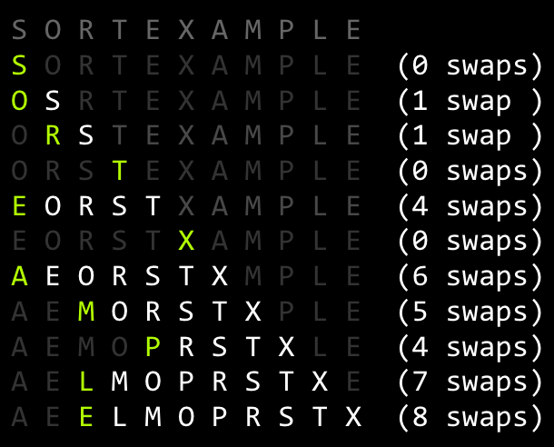
Insertion Sort Runtime: http://yellkey.com/sing
What is the runtime of insertion sort?
Ω(1), O(N)
Ω(N), O(N)
Ω(1), O(N²)
Ω(N), O(N²)
Ω(N²), O(N²)
36 swaps:

Slide 27
Insertion Sort Runtime: http://yellkey.com/sing
What is the runtime of insertion sort?
Ω(1), O(N)
Ω(N), O(N)
Ω(1), O(N²)
Ω(N), O(N²)
Ω(N²), O(N²)
You may recall Ω is not “best case”.
So technnnniically you could also say Ω(1)
36 swaps:

Slide 28
Picking the Best Sort: http://yellkey.com/national
Suppose we do the following:
Read 1,000,000 integers from a file into an array of length 1,000,000.
Mergesort these integers.
Select one integer randomly and change it.
Sort using algorithm X of your choice.
Which sorting algorithm would be the fastest choice for X?
Selection Sort
Heapsort
Mergesort
Insertion Sort

Slide 29
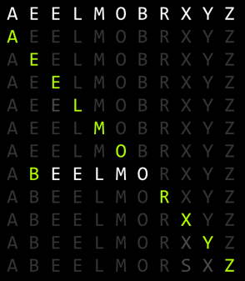
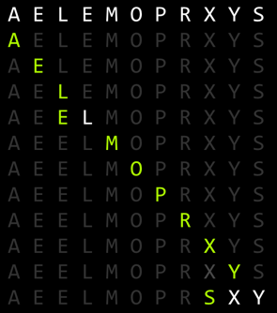
Observation: Insertion Sort on Almost Sorted Arrays
For arrays that are almost sorted, insertion sort does very little work.
Left array: 5 inversions, so only 5 swaps.
Right array: 3 inversion, so only 3 swaps.

Slide 30
Picking the Best Sort (Poll Everywhere)
Suppose we do the following:
Read 1,000,000 integers from a file into an array of length 1,000,000.
Mergesort these integers.
Select one integer randomly and change it.
Sort using algorithm X of your choice.
In the worst case, we have 999,999 inversions: Θ(N) inversions.
Which sorting algorithm would be the fastest choice for X? Worst case run-times:
Selection Sort: Θ(N²)
Heapsort: Θ(N log N)
Mergesort: Θ(N log N)
Insertion Sort: Θ(N)

Slide 31
Insertion Sort Sweet Spots
On arrays with a small number of inversions, insertion sort is extremely fast.
One exchange per inversion (and number of comparisons is similar). Runtime is Θ(N + K) where K is number of inversions.
Define an almost sorted array as one in which number of inversions ≤ cN for some c. Insertion sort is excellent on these arrays.
Less obvious: For small arrays (N < 15 or so), insertion sort is fastest.
More of an empirical fact than a theoretical one.
Theoretical analysis beyond scope of the course.
Rough idea: Divide and conquer algorithms like heapsort / mergesort spend too much time dividing, but insertion sort goes straight to the conquest.
The Java implementation of Mergesort does this (Link).

Slide 32
Sorts So Far
 | Best Case Runtime | Worst Case Runtime | Space | Demo | Notes
Selection Sort | Θ(N²) | Θ(N²) | Θ(1) | Link
Heapsort (in place) | Θ(N)* | Θ(N log N) | Θ(1) | Link | Bad cache (61C) performance.
Mergesort | Θ(N log N) | Θ(N log N) | Θ(N) | Link | Fastest of these.
Insertion Sort (in-place) | Θ(N) | Θ(N²) | Θ(1) | Link | Best for small N or almost sorted.

Slide 33
Shell’s Sort (Extra)
(Not on Exam)

Slide 34
Optimizing Insertion Sort: Shell’s Sort
Big idea: Fix multiple inversions at once.
Instead of comparing adjacent items, compare items that are one stride length h apart.
Start with large stride, and decrease towards 1.
Example: h = 7, 3, 1.
Notes:
Named after Donald Shell, its inventor. Not named after some sort of sea shell game.

Slide 35
Optimizing Insertion Sort: Shell’s Sort
h=1 is just insertion sort.
7-sorting:
3 swaps
1-sorting:
6 swaps
S O R T E X A M P L E
M O R T E X A S P L E (1 swap, > 1 inversion)
M O R T E X A S P L E (0 swaps)
M O L T E X A S P R E (1 swap, > 1 inversion)
M O L E E X A S P R T (1 swap, > 1 inversion)
A E L E O P M S X R T
A E L E O P M S X R T
A E L E O P M S X R T
A E L E O P M S X R T
A E E L O P M S X R T
A E E L O P M S X R T
A E E L O P M S X R T
A E E L M O P S X R T
A E E L M O P S X R T
A E E L M O P S X R T
A E E L M O P R S X T
A E E L M O P R S T X
3-sorting:
5 swaps
M O L E E X A S P R T
E O L M E X A S P R T (1 swap, >1 inversions)
E E L M O X A S P R T (1 swap, >1 inversions)
E E L M O X A S P R T (0 swaps, 0 inversions)
A E L E O X M S P R T (2 swaps, >1 inversions)
A E L E O X M S P R T (0 swaps, 0 inversions)
A E L E O P M S X R T (1 swaps, >1 inversions)
A E L E O P M S X R T (0 swaps, 0 inversions)
A E L E O P M S X R T (0 swaps, 0 inversions)
Total swaps: 14 (vs. 31)
Example from Algorithms 4th Edition

Slide 36
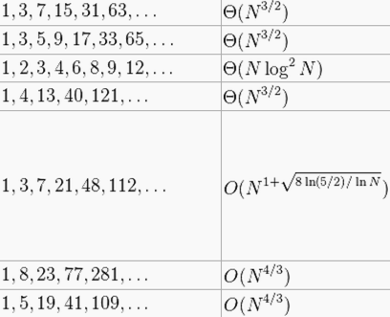
Shell’s Sort: Generalization and Performance
h=1 is just normal insertion sort.
By using large strides first, fixes most of the inversions.
We used 7, 3, 1. Can generalize to 2^{k} - 1 from some k down to 1.
Requires Θ(N^{1.5}) time in the worst case (see CS170).
Other stride patterns can be faster.

Slide 37
Sorts So Far
 | Best Case Runtime | Worst Case Runtime | Space | Demo | Notes
Selection Sort | Θ(N²) | Θ(N²) | Θ(1) | Link
Heapsort (in place) | Θ(N)* | Θ(N log N) | Θ(1) | Link | Bad cache (61C) performance.
Mergesort | Θ(N log N) | Θ(N log N) | Θ(N) | Link | Fastest of these.
Insertion Sort (in-place) | Θ(N) | Θ(N²) | Θ(1) | Link | Best for small N or almost sorted.
Shell’s Sort | Θ(N) | Ω(N log N), O(?) | Θ(1) | N/A | Rich theory!
An earlier version of this slide assumed that Heapsort was always given an array with no duplicate elements. If we omit this assumption, heapsort’s best case is Θ(N).

Slide 38
Citations
Lego man: http://thetechnicgear.com/wp-content/uploads/2014/02/sorting-lego.jpg
Keynote Animations of Algorithms courtesy of Kevin Wayne

